Slide 1
Final 2020 Report
WBAF SURVEY
Pandemic Impact on Women Entrepreneurship
A Global Survey
Initiated By The
WBAF Global Startup Committee
July 27th-Sep.18th, 2020

Slide 2
Key Survey Highlights

Slide 3
Responses From: 77 Countries
Top Countries With Highest Responses:
Turkey
USA
Mexico
South Africa
India
UK
Zambia

Slide 4
Responses From: 77 Countries
Countries With Most Business HQS in our Survey
USA
Turkey
Mexico
South Africa
UK
Zambia

Slide 5
Top 5 Industries Affected
Finance & Financial Services
Business Support
Education
Telecommunications
Food & Beverages

Slide 6
Key Survey Highlights

Slide 7
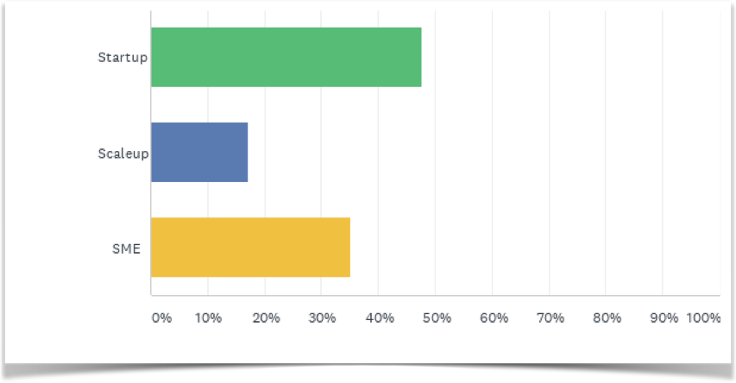
Q6: How would you categorize your business?
Answered: 273 Skipped: 25

Slide 8
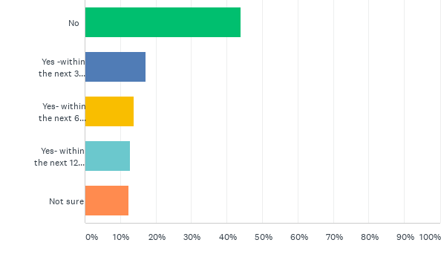
Q10: Are you planning to open a new business?
Answered: 298 Skipped: 0

Slide 9
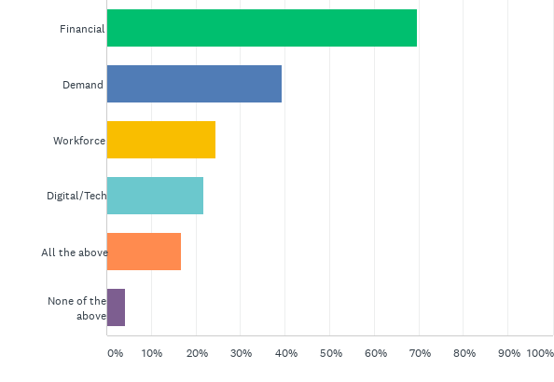
Q11: What types of challenges have you faced in your business since the onset of the pandemic?
Answered: 257 Skipped: 41

Slide 10
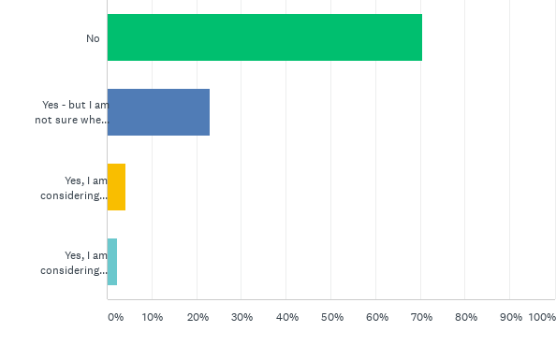
Q12: Have any pandemic-related challenges cause you to consider closing your business?
Answered: 257 Skipped: 41

Slide 11
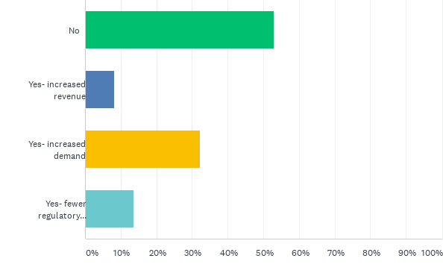
Q13: Has the pandemic affected your business in any positive way?
Answered: 257 Skipped: 41

Slide 12
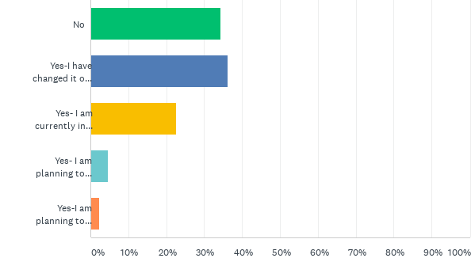
Q14: Have you changed your business model since the onset of the pandemic?
Answered: 257 Skipped: 41

Slide 13
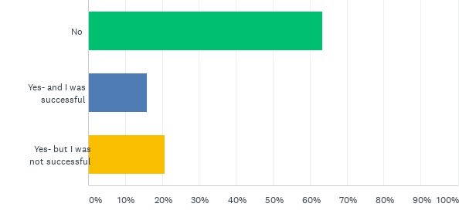
Q15: Have you applied for any additional funding since the pandemic onset?
Answered: 257 Skipped: 41

Slide 14
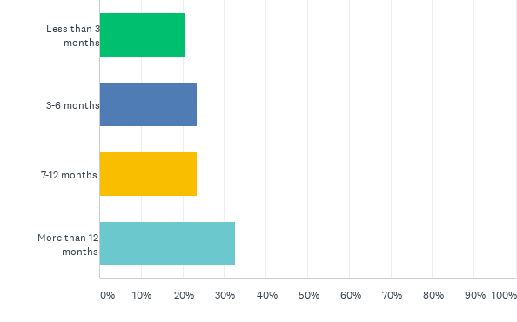
Q18: How long can your business last without additional funding?
Answered: 257 Skipped: 41

Slide 15
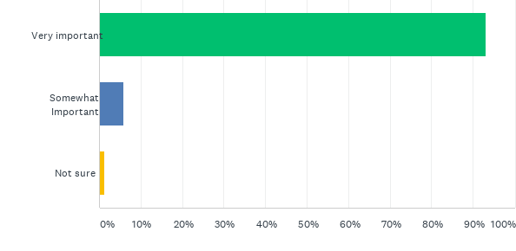
Q23: How important will digital transformation be in the post-pandemic economy?
Answered: 257 Skipped: 41

Slide 16
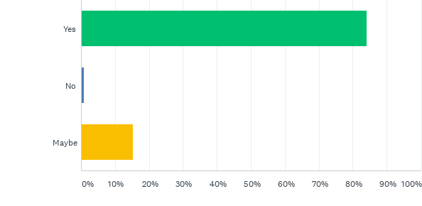
Q24: Would you be willing to invest in the digital transformation of your business?
Answered: 257 Skipped: 41

Slide 17
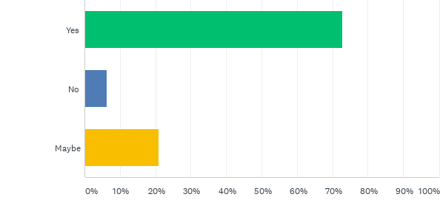
Q26: Would you consider investing in a digital technology business?
Answered: 257 Skipped: 41

Slide 18
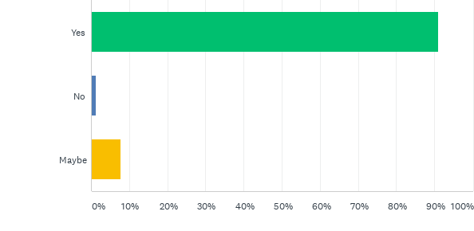
Q25: Do you believe digital fluency will be essential in the post-pandemic economy?
Answered: 257 Skipped: 41

Slide 19
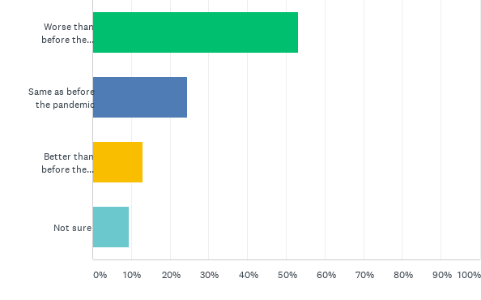
Q27: How would you rate the conditions for women entrepreneurship since the onset of the pandemic?
Answered: 245 Skipped: 53

Slide 20
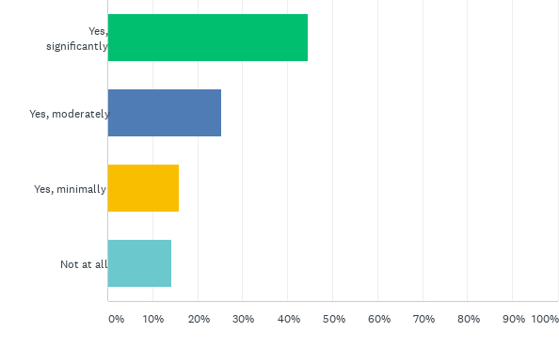
Q39: Has the pandemic affected your personal standard of living?
Answered: 245 Skipped: 53

Slide 21
Detailed Survey Report

Slide 22
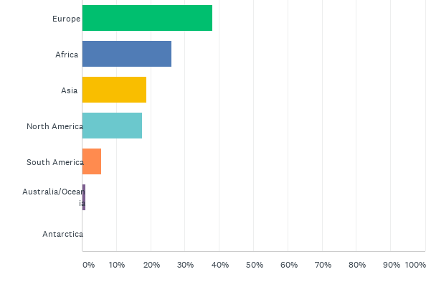
Q4: On which continent are your business headquarters located?
Answered: 283 Skipped: 15

Slide 23
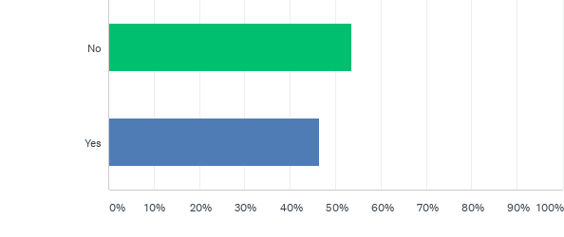
Q7: Do you own more than one business?
Answered: 295 Skipped: 3

Slide 24
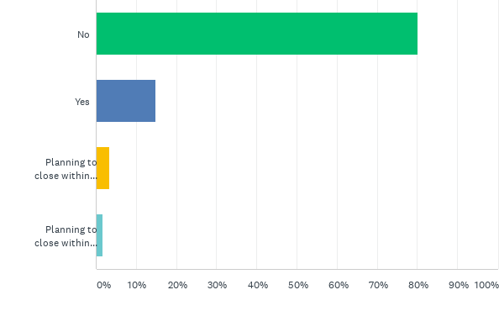
Q8: Have you closed a business since the onset of the pandemic?
Answered: 298 Skipped: 0

Slide 25
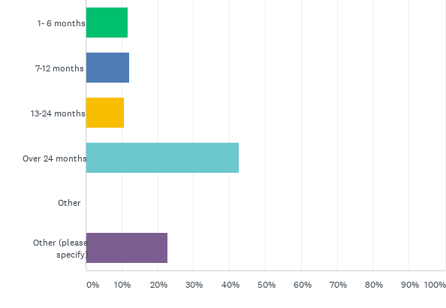
Q9: For how long have you owned your current business?
Answered: 298 Skipped: 0

Slide 26
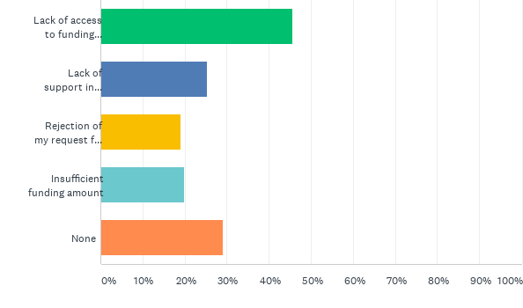
Q16: What barriers to funding have you experienced since the pandemic onset?
Answered: 257 Skipped: 41

Slide 27
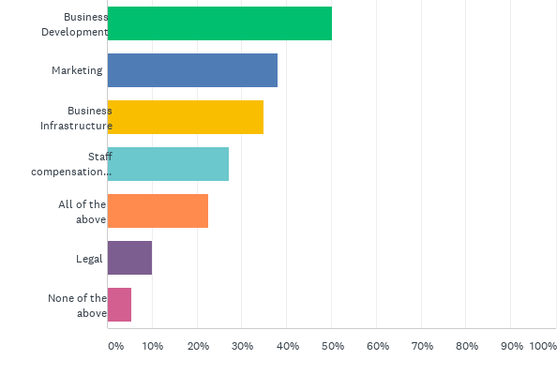
Q17: How would you allocate any additional funding you might receive?
Answered: 257 Skipped: 41

Slide 28
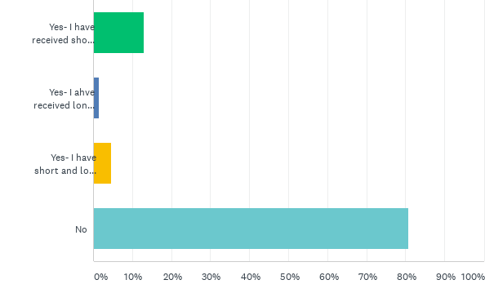
Q19: Has your business funding increased since the onset of the pandemic?
Answered: 255 Skipped: 43

Slide 29
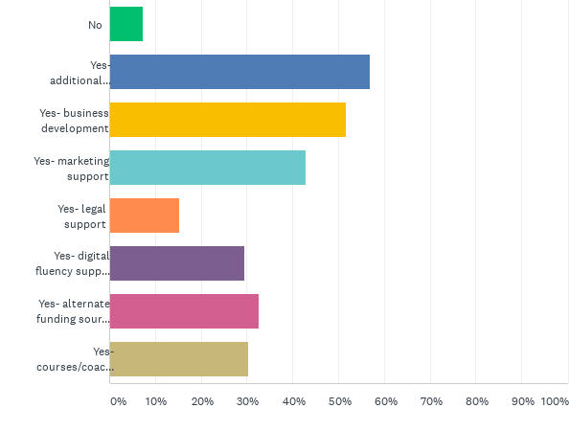
Q20: Do you need any support for your business, either now or after the pandemic?
Answered: 257 Skipped: 41

Slide 30
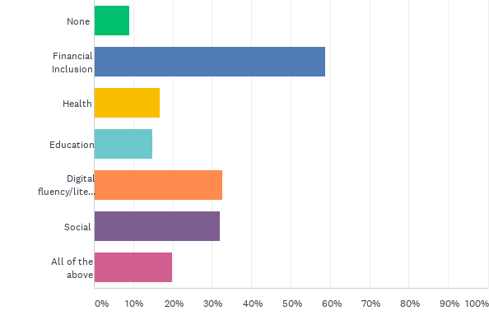
Q21: Since the onset of the pandemic, which of the following factors has created the most difficulties for women entrepreneurship?
Answered: 257 Skipped: 41

Slide 31
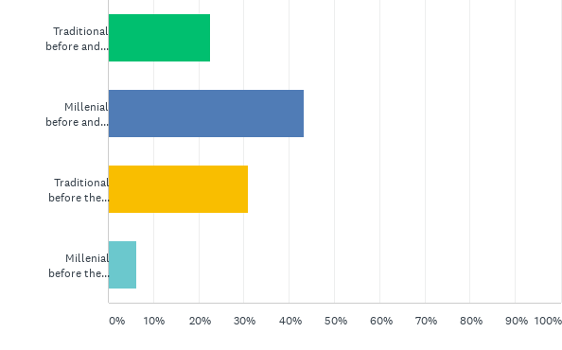
Q22: Which of the following mindsets best describes your business before and since the onset of the pandemic?
Answered: 243 Skipped: 55

Slide 32
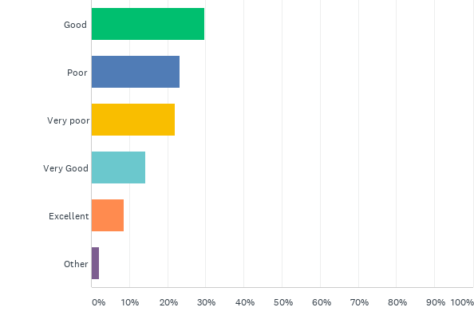
Q28: How would you rate your government's response to the pandemic?
Answered: 245 Skipped: 53

Slide 33
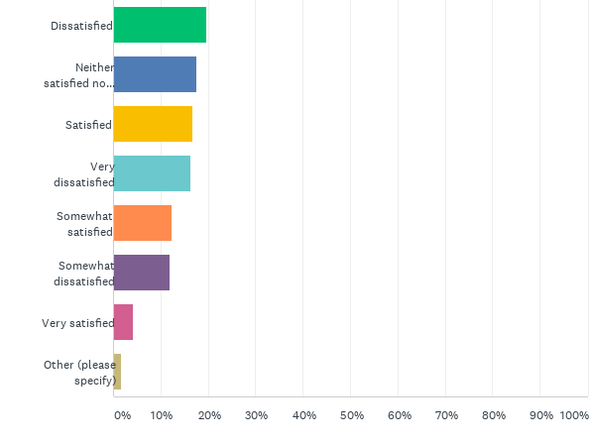
Q29: How do you feel about your government's post-pandemic recovery plan?
Answered: 245 Skipped: 53

Slide 34
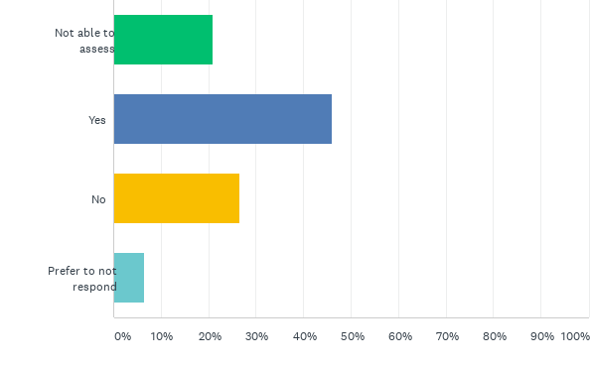
Q30: Has childcare been a challenge during this pandemic for your family or in your community?
Answered: 245 Skipped: 53

Slide 35
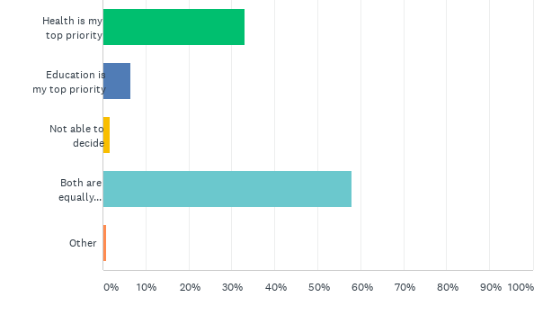
Q31: How would you prioritize health and education?
Answered: 245 Skipped: 53

Slide 36
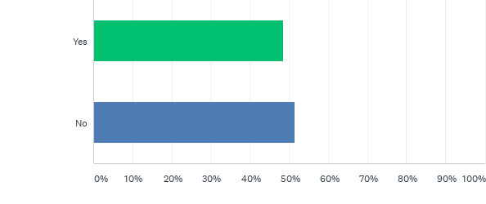
Q32: Has internet access or speed been a challenge for you during this pandemic?
Answered: 245 Skipped: 53

Slide 37
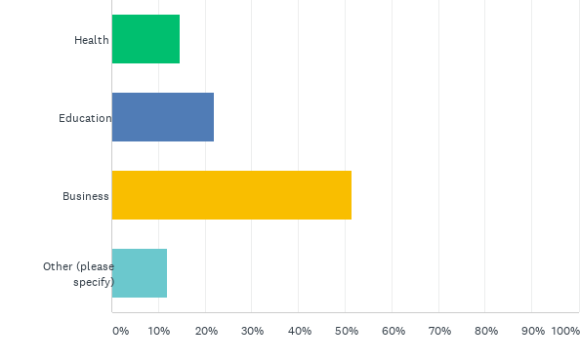
Q33: Which domain has been most challenging for you due to problems with internet access or speed?
Answered: 245 Skipped: 53

Slide 38
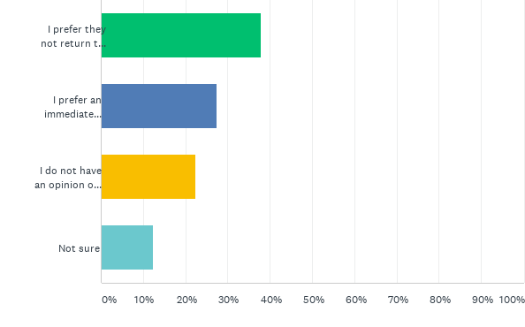
Q34: What is your preference for returning to school plans for children in your family or in your community?
Answered: 245 Skipped: 53

Slide 39
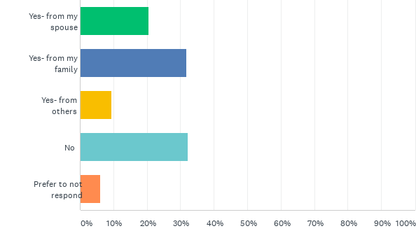
Q35: Have you had any support during this pandemic
Answered: 245 Skipped: 53

Slide 40
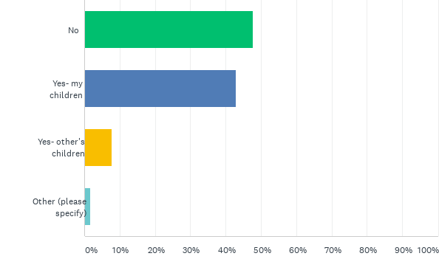
Q36: Have you had any childcare responsibilities during the pandemic?
Answered: 245 Skipped: 53

Slide 41
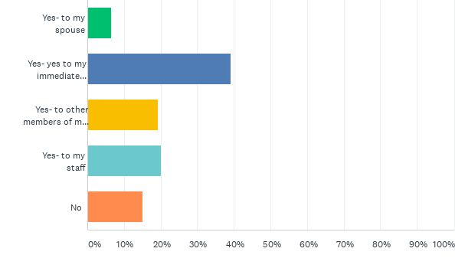
Q37: Have you had to provide any support to anyone else during this pandemic?
Answered: 245 Skipped: 53

Slide 42
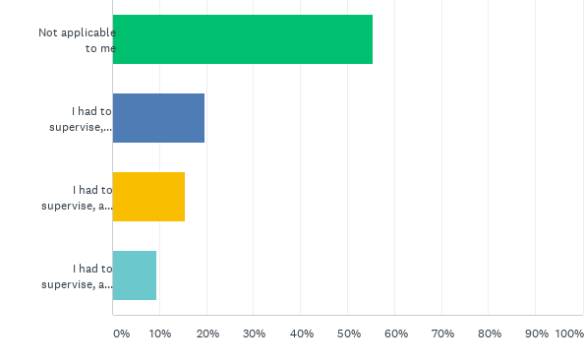
Q38: If you have had to supervise your child's education during the pandemic please indicate if and how this has impacted your business?
Answered: 245 Skipped: 53

Slide 43
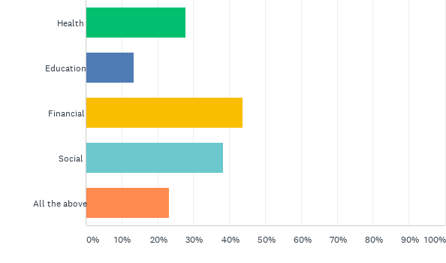
Q40: Which domain has been the most challenging for you to manage during the pandemic?
Answered: 245 Skipped: 53

Slide 44
Questions?

Slide 45
Closing Remarks
Professor Inderjit Singh

Slide 46
Comparative Findings Executive Summary
Our WBAF survey report findings were consistent with surveys done by other major international organizations over the past few months.
WBAF did a survey of the global start-up community in May this rear. The Major issues faced by women entrepreneurs are consistent with issues faced by all entrepreneurs.
But Women entrepreneurs faced even greater challenges compared to their male counterparts, as you have seen from the survey results presented earlier.
So Women entrepreneurs paid a greater price caused by the disruption of the Covid-19 pandemic.

Slide 47
Other Global Surveys Key Findings (I)
Women Faced Greater Impact than Men
About 60% of jobs that have been lost during this pandemic were held by Women.
Gender gap for access to mobile internet is 23%
Women-led businesses faced more severe impact on their operations
Women entrepreneurs faced a disproportionate lack of access to funding
and digital tools

Slide 48
Other Global Surveys Key Findings (II)
Women Faced Greater Discriminatory Issues
Many women were forced to leave their jobs due to child care issues
Higher burden of care responsibilities
Rising domestic and workplace violence
More difficulty adapting to a highly digitalized environment

